Slide 1
Methods and Encapsulation
PRESENTED BY : AHMED SHALABI

Slide 2
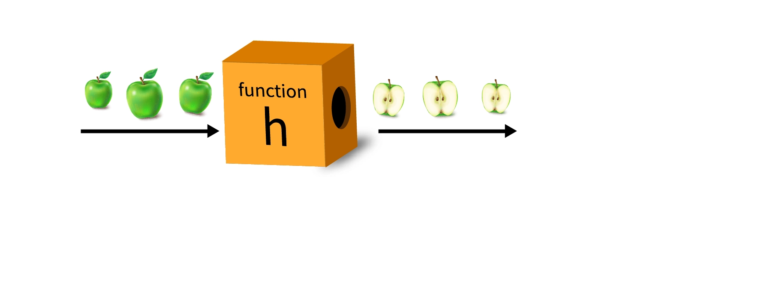
What is Method? Why?
A “Method” is a block of code that preforms a specific action or task. It’s way to organize and encapsulate behavior within Object Oriented Programming.

Slide 3
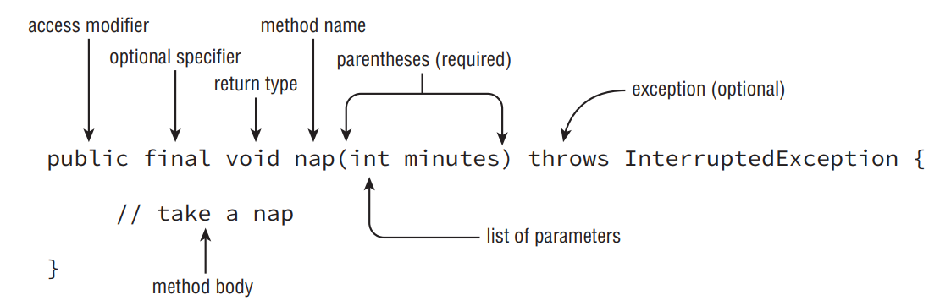
Method Declaration

Slide 4








Methods and Encapsulation

Slide 5

Access Modifiers

Slide 6
Access Modifiers
Access modifiers are used to define the scope and visibility of classes, variables, methods, and other members.
Private : Method can be called only from the same “Class”.
Default : Method can be called from same class or same package classes.
Protected : Method can be called from classes in the same package or subclasses.
Public : Method can be called from any “Class” .

Slide 7
Private Access
Legal code
package pond.duck;
public class FatherDuck {
private String noise = "quack";
private void quack() {
System.out.println(noise);}
private void makeNoise() {
quack(); } }
Illegal code
package pond.duck;
public class BadDuckling {
public void makeNoise() {
FatherDuck duck = new FatherDuck();
duck.quack();
System.out.println(duck.noise);} }
Compile Error, outside class scope !

Slide 8
Default Access
Legal Code
package pond.duck;
public class FatherDuck {
private String noise = "quack";
void quack() {
System.out.println(noise);
}
void makeNoise() {
quack(); } }
package pond.duck;
public class BadDuckling {
void makeNoise() {
FatherDuck duck = new FatherDuck();
duck.quack();
System.out.println(duck.noise);
}
}

Slide 9
Default Access
Illegal code
package pond.duck;
public class FatherDuck {
String noise = "quack";
void quack() {
System.out.println(noise);
}
void makeNoise() {
quack(); } }
package pond.swan;
import pond.duck.FatherDuck;
public class BadCygnet {
public void makeNoise() {
FatherDuck duck = new FatherDuck ();
duck.quack();
System.out.println(duck.noise} }
Compile Error, outside package scope !

Slide 10
Protected Access
Legal Code
package pond.shore;
public class Bird {
protected String text = "floating"
protected void floatInWater() {
System.out.println(text);
}
}
package pond.goose;
import pond.shore.Bird;
public class Gosling extends Bird {
public void swim() {
@Override
floatInWater(){
super.floatInWater};
System.out.println(text);}
}

Slide 11
Protected Access
Illegal Code
package pond.shore;
public class Bird {
protected String text = "floating"
protected void floatInWater() {
System.out.println(text);
}
}
package pond.inland;
import pond.shore.Bird;
public class BirdWatcherFromAfar {
public void watchBird() {
Bird bird = new Bird();
bird.floatInWater();
}
}
Compile Error, not a subclass !

Slide 12
Public Access
Legal Code
package pond.duck;
public class DuckTeacher {
public String name = "Swimming";
public void swim()
System.out.println(name);
}
}
package pond.goose;
import pond.duck.DuckTeacher;
public class LostDuckling {
public void swim() {
DuckTeacher teacher = new DuckTeacher();
teacher.swim();
}
}

Slide 13

Static Method and Variable

Slide 14
Static Method and Variable
A method or variable is called “static” when the members belong to a class itself, rather than to instances.
Properties:
Facilitates convenient access via the class name.
Attributed to the class itself, not its instances.
Initialization occurs singularly upon class loading.
Memory allocation is singular during program execution.
Shared universally among all class instances.
* Note other members initialized once creating new object.

Slide 15
Static Method and Variable
Legal
public class Static {
private static String name = "Static class";
public static void first() {
System.out.println(name); }}
public class Main {
public static void main(String[] args) {
Static.first();
}
}
Illegal
public class Static {
private String name = "Static class";
public static void first() {}
public void second() {
System.out.println(name);}}
public class Main {
public static void main(String[] args) {
Static.first();
Static.second();}}
Compile Error, access not static method

Slide 16
Static Initialization
A “Static initialization” is the act of initializing static variables or executing static code blocks when a class is initially loaded into memory.
Class MyClass {
static {
// Code Block
}
}
🡪

Slide 17
Static Imports
The “Static imports” enable direct access to static members (fields and methods) of a class without needing the class name.
import java.util.List;
import static java.util.Arrays.asList; // static import
public class StaticImports {
public static void main(String[] args) {
List<String> list = asList("one", "two"); // no ‘Arrays’.
}
}

Slide 18

Passing Data Among Methods

Slide 19
Passing Data Among Methods
The concept of “pass-by-value” is used in Java in passing the data into the method.
Passing primitive : When passing a primitive data type, a copy of the actual value is passed to the method. Changes affects only parameter within the method.
Passing object : When passing an object, a copy of the reference to the object is passed to the method. Changes will affect the original object.

Slide 20

Overloading Methods

Slide 21
Overloading Methods
Method “overloading” takes place when various method declarations share an identical name, yet they are distinguished by employing dissimilar type parameters.
Legal
public void fly(int numMiles) { }
public void fly(short numFeet) { }
public boolean fly() { return false; }
void fly(int numMiles, short numFeet) { }
Illegal
public void fly(int numMiles) { }
public int fly(int numMiles) { }
public static void fly(int numMiles) { }
public void chips(int[] lengths) { }
public void chips(int... lengths) { }

Slide 22
Order of Choosing Method
Exact match by type | public String glide(int i, int j) {}
Larger primitive type | public String glide(long i, long j) {}
Autoboxed type | public String glide(Integer i, Integer j) {}
Varargs | public String glide(int... nums) {}

Slide 23

Constructors

Slide 24
Constructors
A “Constructor” is a method that has no return type;
Its name matches the class name;
Typically used to initialize instance variables
The key word ‘this’ is used to distinguish between the local variable and the parameter if they have the same name.
Class MyClass{
private String value;
MyClass(String value){
this.value = value ;
}
}
🡪

Slide 25
Default Constructor
A “default constructor” is provided in each class whether it has been coded or not, Java will create one if it hasn’t been coded.
class MyClass {
// arguments and methods
}
MyClass instance = new MyClass();
🡪

Slide 26
Overloading Constructors
When “overloading constructors”,
the name remains constant
Consequently, constructors must
possess distinct parameters to
enable overloading.
class MyClass {
private int num;
Myclass(int num){
this.num = num;
}
MyClass(){};
}
🡪

Slide 27
Order of Initialization
Superclass.
Static variable declarations and static initializers in the order they appear in the file.
Instance variable declarations and instance initializers in the order they appear in the file.
The constructor.

Slide 28
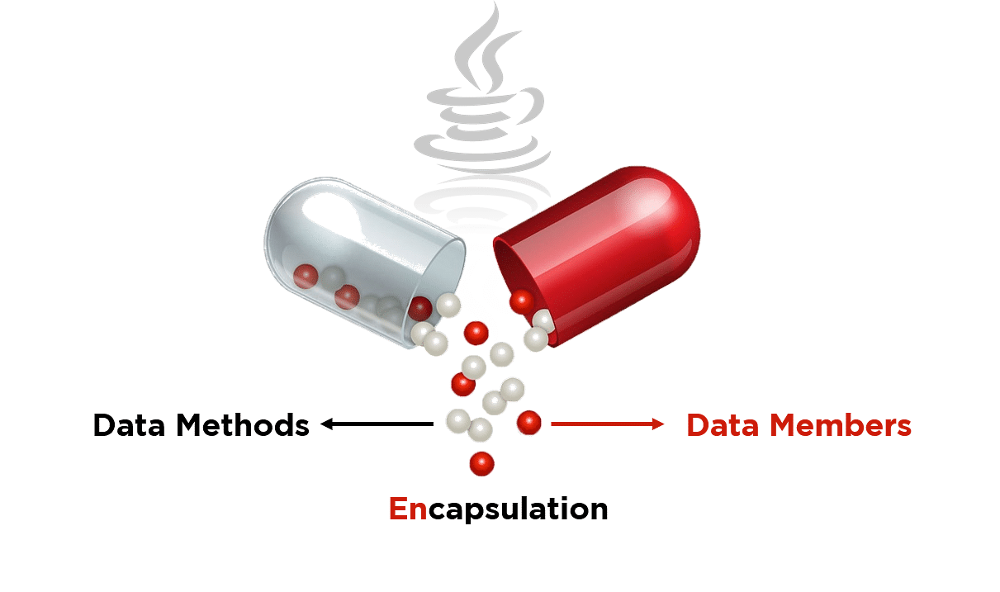
Encapsulating Data

Slide 29
Encapsulating Data
Encapsulation means we set up the class so only methods in the class with the variables can refer to the instance variables. Callers are required to use these methods.
public class Swan {
private int numberEggs;
public int getNumberEggs() {
return numberEggs;}
public void setNumberEggs(int numberEggs) {
if (numberEggs >= 0)
this.numberEggs = numberEggs; } }
🡪

Slide 30
Creating Immutable Classes
Immutable classes are helpful because you know they will always be the same. You can pass them around your application with a guarantee that the caller didn’t change anything.
public class MyClass {
private int number;
public MyClass(int Number) {
this.number = number;
}
public int getNumber(){}
}
🡪

Slide 31
Encapsulating Data
Getters begin with ‘ is ’ if boolean | public boolean isHappy() { return happy;}
Getters begin with ‘ get ’ other than boolean | public int getNumEggs() { return numEggs;}
Setters begin with ‘ set ’ | public void setHappy(boolean happy) { this.happy = happy;}

Slide 32

Simple Lambdas

Slide 33
Lambda Expression
A lambda expression in Java is a compact way to define and use small blocks of code;
Used to implement single-method interfaces;
Alternative to traditional anonymous inner
classes.
interface MyFunctionalInterface {
void doSomething(int x, int y);
}
MyFunctionalInterface lambda = ( x , y ) -> x + y;
🡪

Slide 34
Lambda Syntax
No Arguments | () -> System.out.println(“Hello”);
One Arguments | s -> System.out.println(s);
Two Arguments | ( x , y ) -> x + y;
With explicit Argument types | (Integer x , Integer y) -> x + y;
Multiple statements | ( x , y ) -> { System.out.println(x); System.out.println(x); return x + y;}

Slide 35
Predicates
A Predicate is a functional interface introduced in Java 8 that
Represents a boolean-valued function taking an argument and returning a boolean result.
public interface Predicate<T> {
boolean test(T t);
}
🡪

Slide 36

Review Questions

Slide 37
Question 1 : Which line numbers generate a compile error in main() ?
1:package my.city;
2:import my.school.*;
3:public class School {
4: public static void main(String[] args) {
5: System.out.println(Classroom.globalKey);
6: Classroom room = new Classroom(101, "Mrs.Anderson");
7: System.out.println(room.roomNumber);
8: System.out.println(room.floor);
9: System.out.println(room.teacherName); } }
package my.school;
public class Classroom {
private int roomNumber;
protected String teacherName;
static int globalKey = 54321;
public int floor = 3;
Classroom(int r, String t) {
roomNumber = r;
teacherName = t; } }
A. None, the code compiles fine. B. Line 5
C. Line 6 D. Line 7
E. Line 8 F. Line 9
Answer : B,C,D,F

Slide 38
Question 2 : What is the output of the following code ?
import rope.*;
import static rope.Rope.*;
public class RopeSwing {
private static Rope rope1 = new Rope();
private static Rope rope2 = new Rope();
{ System.out.println(rope1.length); }
public static void main(String[] args) {
rope1.length = 2;
rope2.length = 8;
System.out.println(rope1.length);}
}
package rope;
public class Rope {
public static int length = 0;
}
A. 02 B. 08
C. 2 D. 8
E. The code does not compile. F. An exception is thrown.
Answer : D

Slide 39
Question 3 : What is the output of the following code ?
Public class Main{
public static void main(String[] args) {
new Create(100);
new Create(1000L);
}
}
public class Create {
Create() {
System.out.print("1 ");
}
Create(int num) {
System.out.print("2 ");
}
Create(Integer num) {
System.out.print("3 ");
}
Create(Object num) {
System.out.print("4 ");
}}
A. The code prints out 2 4. B. The code prints out 3 4.
C. The code prints out 4 2. D. The code prints out 4 4.
E. The code prints 3 4 if you remove the constructor Create(int num).
F. The code prints 4 4 if you remove the constructor Create(int num).
Answer : A,E

Slide 40
Question 4 : What is the output of the following code ?
Public class Main{
public static void main(String[] args) {
Order order = new Order("f");
order = new Order();
System.out.println(order.value);
}
}
public class Order {
String value = "t";
{ value += "a"; }
{ value += "c"; }
public Order() {
value += "b";
}
public Order(String s) {
value += s;
}
}
A. tacb B. tacf
C. tacbf D. tacfb
E. tacftacb F. The code does not compile.
Answer : A

Slide 41
Question 5 : What is the output of the following code ?
1: import java.util.function.*;
2: public class Panda {
3: int age;
4: public static void main(String[] args) {
5: Panda p1 = new Panda();
6: p1.age = 1;
7: check( p1, p -> p.age < 5 );
}
8: private static void check(Panda panda, Predicate<Panda> pred) {
9: String result = pred.test(panda) ? "match" : "not match";
10: System.out.print(result);
}
}
A. match B. not match
C. Compiler error on line 8. D. Compiler error on line 10.
E. Compiler error on line 11. F. A runtime exception is thrown.
Answer : A

Slide 42

Any Question ?

Slide 43

Thank You!

